Slide 1


DEPARTMENT OF INFORMATION TECHNOLOGY
SCHOOL OF COMPUTING
10214IT602 MINOR PROJECT -II
WINTER SEMESTER(2023-2024)
SEMESTER END PROJECT VIVA VOCE EXAMINATIONS
“INTRUSION DETECTION USING MACHINE LEARNING TECHNIQUES”
PRESENTED BY
SUPERVISED BY
Mr. SURESH KUMAR, ME., Ph.D.,
.
1. ARAVIND G (23965) (21UTIT0501)
2. JEEVAN KUMAR R (23956) (21UTIT0502)
3. SIVARAMAN K (19888) (21UTIT0063)

Slide 2
OVERVIEW
ABSTRACT
OBJECTIVE
INTRODUCTION
LITERATURE REVIEW (SOFT COPY OF PAPERS TO BE LINKED AS HYPERLINK)
DESIGN AND METHODOLOGIES
IMPLEMENTATION
TESTING
INPUT AND OUTPUT
INCLUDE DEMO VIDEO-1 (Till REVEW-1)
INCLUDE DEMO VIDEO-2(Complete Implementation of Project)
CONCLUSION
WEB REFERENCES LINK (TILL REVIEW DATE ALL LINKS TO BE INCLUDED DAY WISE)
PLAGIARISM REPORT OF PPT
REFERENCES

Slide 3
ABSTRACT
In an era defined by unprecedented digital connectivity, the importance of safeguarding networks and systems against cyber threats cannot be overstated. As organizations and individuals increasingly rely on interconnected infrastructures for communication, commerce, and critical services.The development of robust cybersecurity measures becomes imperative, and at the forefront of these measures is the implementation of effective Intrusion Detection and Prevention Systems (IDPS).
The purpose of developing and implementing an Intrusion Detection and Prevention System (IDPS) is multifaceted, driven by the evolving landscape of cybersecurity threats and the imperative to safeguard digital assets
The development and deployment of an Integrated Intrusion Detection and Prevention System (IDPS) emerge as a critical component in the defense against malicious activities that seek to exploit vulnerabilities in networks and systems. This paper has explored the key components, algorithms, and purposes that contribute to the efficacy of an IDPS, highlighting its significance in the contemporary cybersecurity paradigm.

Slide 4
OBJECTIVES
Aim of the Project:
The aim of the project is to design, implement, and evaluate an Integrated Intrusion Detection and Prevention System (IDPS) with the overarching goal of enhancing cybersecurity in the face of evolving and sophisticated cyber threats.
Develop and implement advanced anomaly detection algorithms to identify deviations from normal network behavior.
Utilize machine learning techniques to enhance the system's ability to recognize and respond to novel and previously unseen threats.
Scope of the Project:
Define the architectural framework of the IDPS, specifying the components, modules, and their interconnections.
Identify the hardware and software requirements necessary for the successful deployment of the system.
Develop a user-friendly interface for system administrators to monitor and manage the IDPS effectively.
Implement reporting and alert mechanisms to facilitate timely response to security incidents.

Slide 5
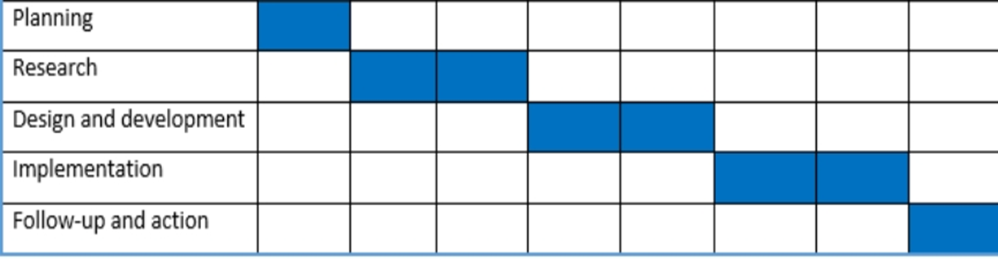
TIMELINE OF THE PROJECT
Gannt Feburary 2024 March 2024 April 2024

Slide 6
INTRODUCTION
These days, most individuals seem to be terrified by biological and cyber warfare that steal their data. Cybersecurity has grown in importance because nearly all of the data that is gathered, processed, and kept in computers, the cloud, and other storage systems by federal, military, commercial, financial, and healthcare organizations is sensitive and could be jeopardized by unauthorized access or exposure.
A few hours of cyberspace intrusion might send modern civilization back to the Paleolithic era.
According to the phrase, ”Prevention is better than cure,” attacks can be avoided by using machine learning techniques to detect them sooner. This is the basis for the recommended strategy. Preventing identity theft, data breaches, and cyberattacks is the main goal of this system, which can help with risk management.
By helping in the detection and identification of a potential attack, this technology enhances cyber security staff through innovative concepts and cutting-edge algorithms. Consequently, an intrusion detection system has been developed that employs machine learning to detect anomalies and potential security breaches.
The Flask-based interface is easy for users to use, and it facilitates effective monitoring and response to security events.

Slide 7
LITERATURE REVIEW
 | Author’s Name | Paper name and publication details | Year of publication | Main content of the paper
 | Akhil Krishna, Ashik Lal M.A. | Intrusion Detection and Prevention System Using Deep Learning | 2021 | As technology is developing day by day and the number of networked digital devices is increasing manifold, the number of intruders and the type of attacks are also increasing
 | Pankaj Ramchandra Chandre, Parikshit Narendra Mahalle | Machine Learning Based Novel Approach for Intrusion Detection and Prevention System: A Tool Based Verification | 2022 | This research paper aims to formally verify as well as model some protocol used for intrusion detection using AVISPA tool and HLPSL language.

Slide 8
Author’s Name | Paper name and publication details | Year of publication | Main content of the paper
Sarode Harshal Vasudeo, Pravin Patil | IMMIX-intrusion detection and prevention system | 2023 | Computer security has become a major problem in our society.computer network security is concerned with preventing the intrusion of an unauthorized person into a network of computers.
Martuza Ahmed,Rima Pal | NIDS: A Network Based Approach to Intrusion Detection and Prevention | 2023 | The techniques used for intrusion detection have their particular problems. Any of the Intrusion Detection Systems proposed so far is not completely flawless.

Slide 9
DESIGN AND METHODOLOGIES
MODULE 1: Intrusion Detection with Decision Tree-Based Pattern Recognition
Algorithm: Decision Tree
Description: This module aims to enhance intrusion detection and prevention capabilities by implementing a Decision Tree algorithm for recognizing patterns associated with known cyberattacks. The Decision Tree algorithm, with its ability to make informed decisions based on hierarchical nodes, serves as a powerful tool for real-time threat categorization and identification.
MODULE 2:Adaptive Threat Analysis Engine for Intrusion Detection
Algorithm: Neural Network
Description:The Dynamic Threat Analysis Engine for Intrusion Detection and Prevention (IDP) leverages a Neural Network algorithm to dynamically analyze real-time data and identify emerging cyberattack patterns.

Slide 10
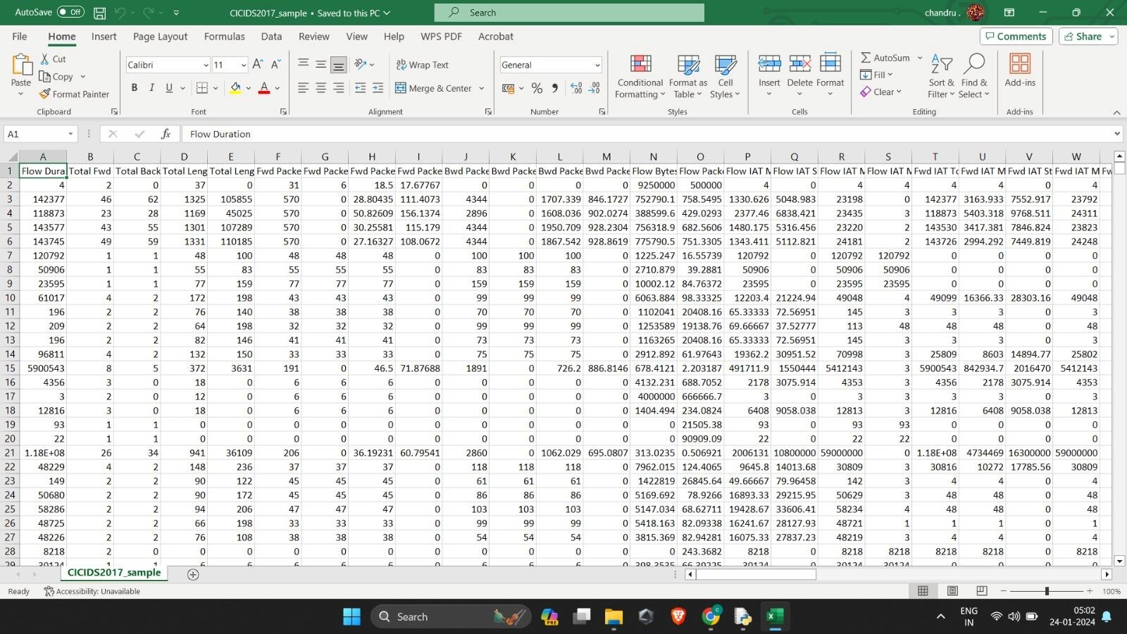
MODULE 1:Intrusion Detection and Prevention with Decision Tree-Based Pattern Recognition
Step:1 Collection of data

Slide 11
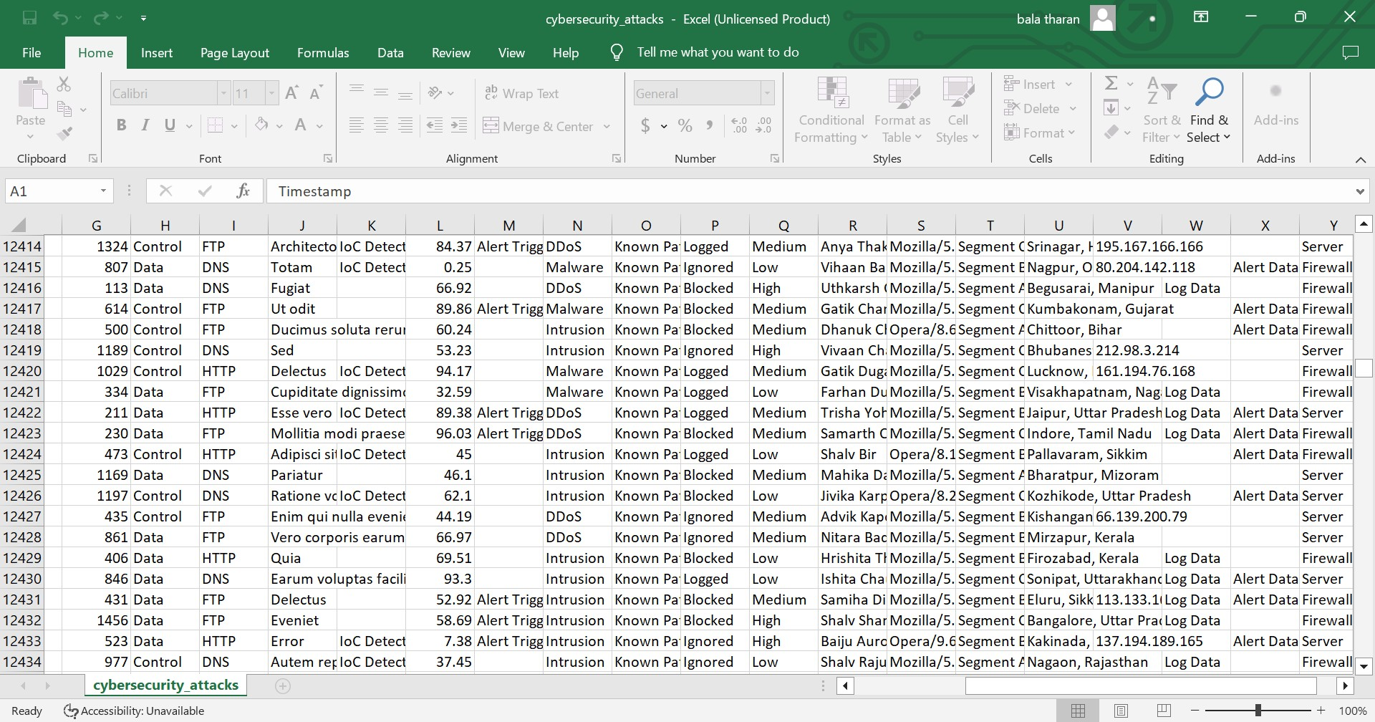
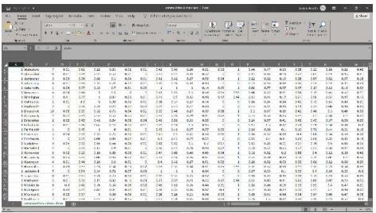
Step 2: Processing the data

Slide 12
Module 2- Adaptive Threat Analysis Engine for Intrusion Detection and Prevention
Algorithm: Neural Network
Description: The Dynamic Threat Analysis Engine employs a neural network algorithm to adaptively analyze real-time data and identify emerging cyberattack patterns. This module ensures the system's capability to evolve and stay updated with the changing landscape of cyber threats.
Real-time Analysis: Operating in real-time is a critical feature of the Dynamic Threat Analysis Engine. This allows the system to provide instantaneous assessments of incoming data streams. Real-time analysis is crucial for promptly identifying and responding to anomalies and potential threats as they unfold, minimizing the window of vulnerability.
Pattern Recognition Expertise: The neural network excels in pattern recognition, a key aspect of identifying cyber threats. Its ability to discern subtle and complex patterns makes it effective in recognizing both known patterns associated with past attacks and new, previously unseen patterns indicative of emerging threats.

Slide 13
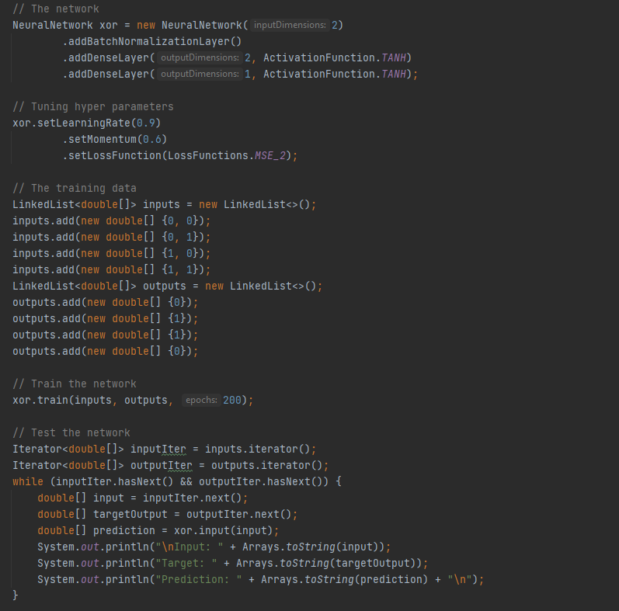
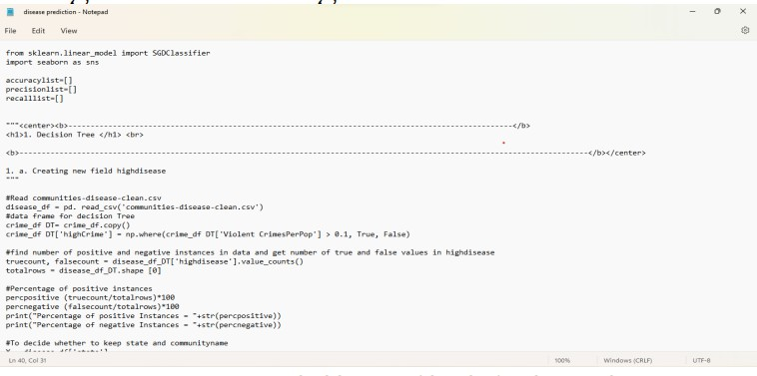
Step 3: Neural Algorithm

Slide 14
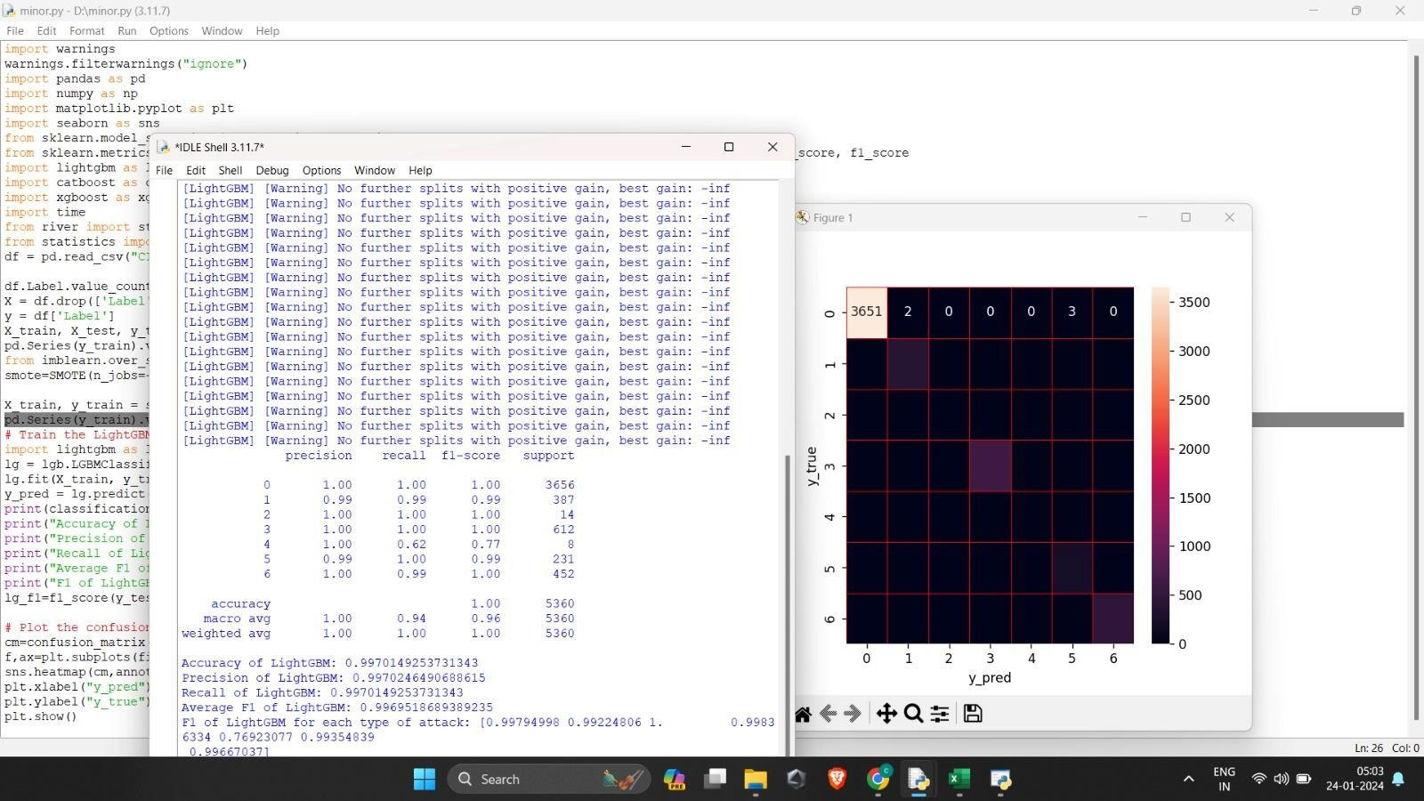
Step 4: The output

Slide 15
IMPLEMENTATION
Architecture Diagram
Data –Flow Diagram
Use Case Diagram
Class Diagram
Activity Diagram
Sequence Diagram
Collaboration Diagram(If applicable)
E-R Diagram

Slide 16
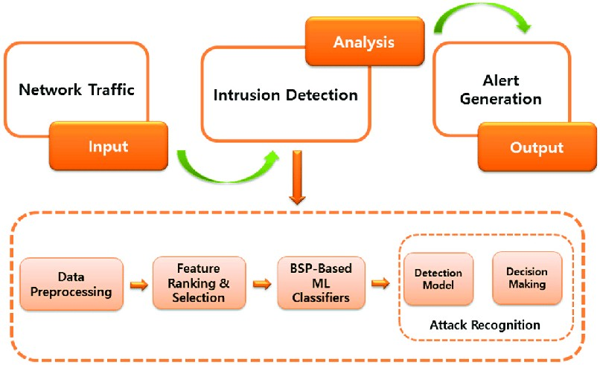
Architecture Diagram

Slide 17
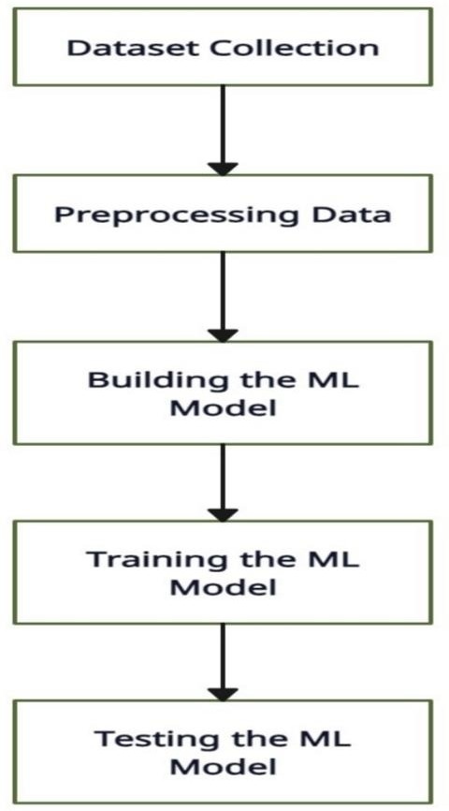
Data –Flow Diagram

Slide 18
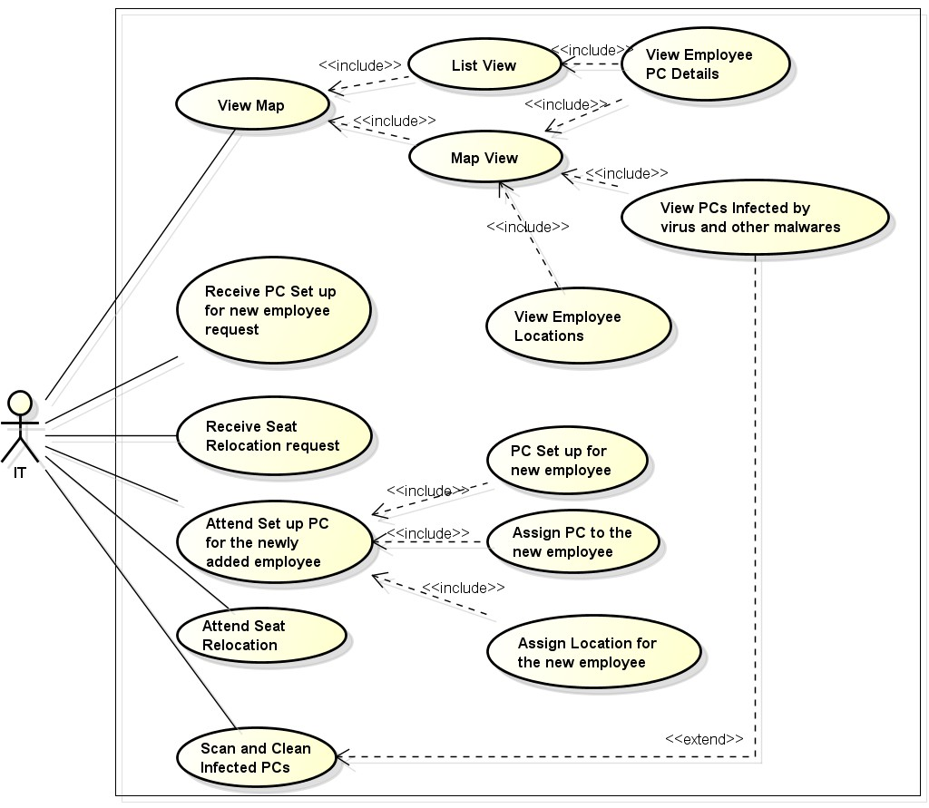
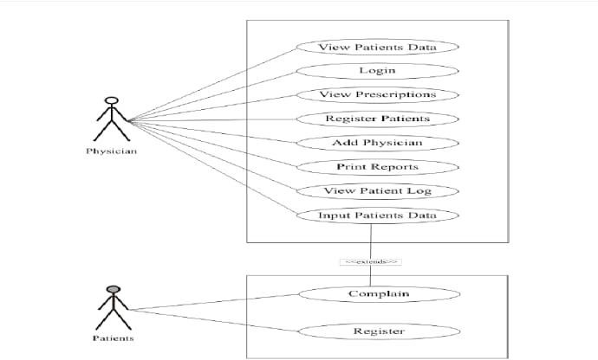
Use Case Diagram

Slide 19
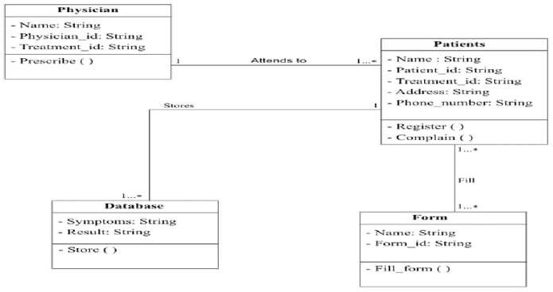
Class Diagram

Slide 20
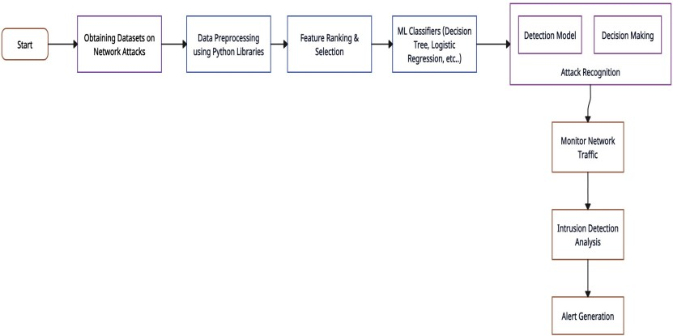
Activity Diagram

Slide 21
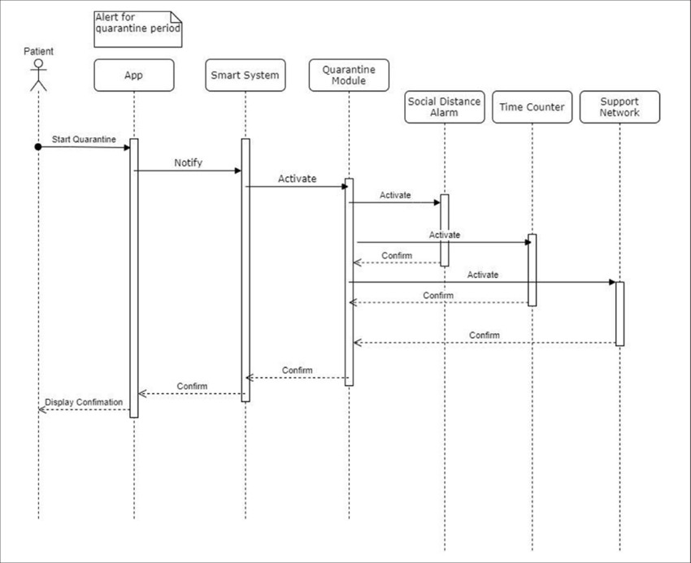
Sequence Diagram

Slide 22
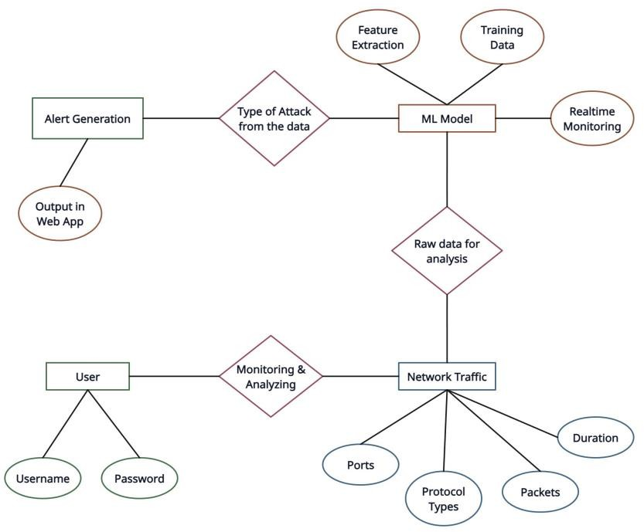
E-R Diagram

Slide 23
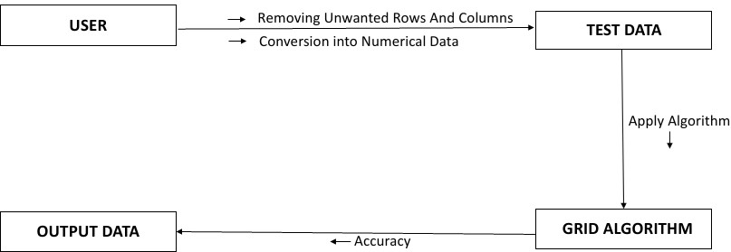
Collaboration Diagram(If applicable)

Slide 24
TESTING
UNIT TESTING
INTEGRATION TESTING

Slide 25
UNIT TESTING
unit testing is a type of software testing that focuses on individual units or components of a software system. The purpose of unit testing is to validate that each unit of the software works as intended and meets the requirements. Unit testing is typically performed by developers, and it is performed early in the development process before the code is integrated and tested as a whole system.
Unit tests are automated and are run each time the code is changed to ensure that new code does not break existing functionality. Unit tests are designed to validate the smallest possible unit of code, such as a function or a method, and test it in isolation from the rest of the system. This allows developers to quickly identify and fix any issues early in the development process, improving the overall quality of the software and reducing the time required for later testing.
INTEGRATION TESTING
Integration testing is a software testing technique that focuses on verifying the interactions and data exchange between different components or modules of a software application. The goal of integration testing is to identify any problems or bugs that arise when different components are combined and interact with each other. Integration testing is typically performed after unit testing and before system testing. It helps to identify and resolve integration issues early in the development cycle, reducing the risk of more severe and costly problems later on.

Slide 26
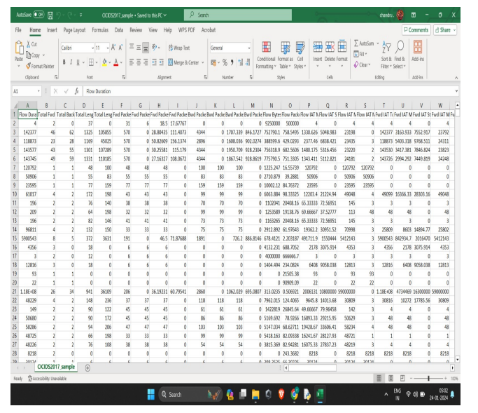
INPUT AND OUTPUT
Raw data

Slide 27
SOURCE CODE
i m p o r t w a r n i n g s
w a r n i n g s . f i l t e r w a r n i n g s ( ” i g n o r e ” )
i m p o r t pandas as pd
i m p o r t numpy as np
i m p o r t m a t p l o t l i b . p y p l o t as p l t
i m p o r t s e a b o r n as s n s
from s k l e a r n . m o d e l s e l e c t i o n i m p o r t t r a i n t e s t s p l i t
from s k l e a r n . m e t r i c s i m p o r t c l a s s i f i c a t i o n r e p o r t , c o n f u s i o n m a t r i x , a c c u r a c y s c o r e , p r e c i s i o n s c o r e ,
r e c a l l s c o r e , f 1 s c o r e
im p o r t l i g h t g b m as l g b
i m p o r t c a t b o o s t as c b t
i m p o r t x g b o o s t as xgb
i m p o r t t ime
from r i v e r i m p o r t s t r e a m
from s t a t i s t i c s i m p o r t mode
df = pd . r e a d c s v ( ” CICIDS2017 sample km . csv ” )
df . Label . v a l u e c o u n t s ( )
X = df . drop ( [ ’ Label ’ ] , a x i s =1)
y = df [ ’ Label ’ ]
X t r a i n , X t e s t , y t r a i n , y t e s t = t r a i n t e s t s p l i t (X, y , t r a i n s i z e = 0 . 8 , t e s t s i z e = 0 . 2 ,
r a n d o m s t a t e = 0) # s h u f f l e = F a l s e
pd . S e r i e s ( y t r a i n ) . v a l u e c o u n t s ( )
from i m b l e a r n . o v e r s a m p l i n g i m p o r t SMOTE
smote=SMOTE( n j o b s = −1 , s a m p l i n g s t r a t e g y ={2 : 1 0 0 0 , 4 : 1 0 0 0})

Slide 28
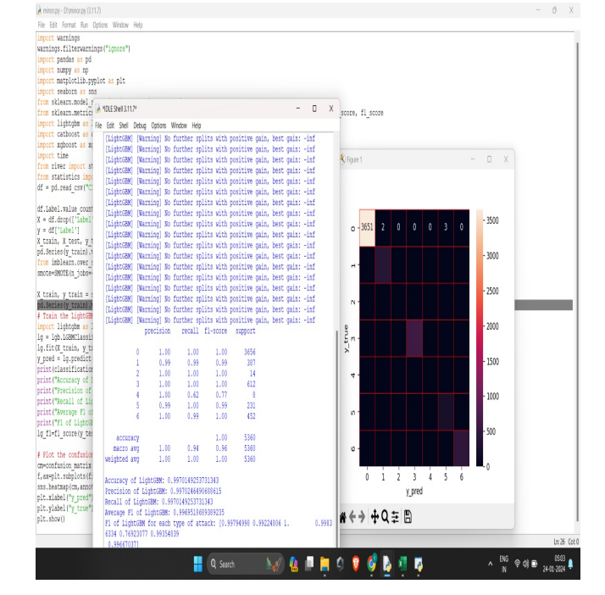
OUTPUT

Slide 29
CONCLUSION
The intrusion detection and intrusion prevention arenas are extremely dynamic, with new findings, functions, and models being created all the time.
A considerable amount of research on data visualization methods for intrusion detection data is also currently being conducted.
At some point, the major breakthroughs from this research will be incorporated into IDSs of the future, resulting in output.
That will be much more useful in terms of identifying threat magnitudes, patterns of elements within incidents, and so forth..

Slide 30
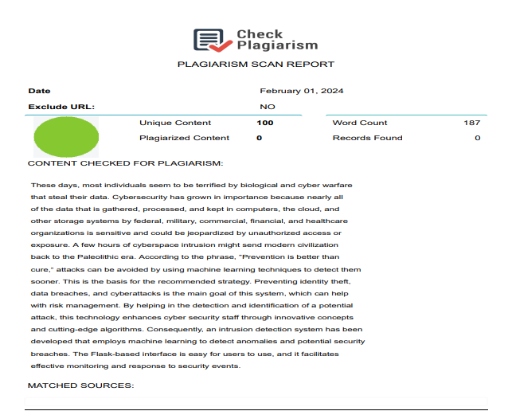
Plagiarism Report of PPT

Slide 31
Web references/video links
https://youtu.be/dfVAi87BSEs?si=HLyEhPN8PwIrQJ9B.
https://youtu.be/R1mF7Mxfynk?si=ywDXKECcuYzGbtCR
https://youtu.be/PTxGEA1dFAw?si=zV5LyDktx8g9mxMF
https://youtu.be/fUMWwDYPjOk?si=XlFGVm1G8nxqNrNB
https://youtu.be/VgyKQ5MTDFc?si=JaaDazHdtFyddQJ9

Slide 32
REFERENCES
. A Survey of Intrusion Detection Systems: Techniques, Challenges, and Opportunities ,M. A. Almalawi, B. C. M. Fung, and M. Debbabi,"A Survey of Intrusion Detection Systems: Techniques, Challenges, and Opportunities,Journal of Network and Computer Applications,2021.
. Deep Learning for Anomaly Detection: A Review ,C. Zhou, R. C. Pusch, and L. T. Yang, "Deep Learning for Anomaly Detection: A Review,"ACM Computing Surveys,2022.
. A Survey of Data Mining and Machine Learning Methods for Cyber Security Intrusion Detection" ,M. Mazuran, G. Vojković, and D. Šarić,"A Survey of Data Mining and Machine Learning Methods for Cyber Security Intrusion Detection,"IEEE Transactions on Systems, Man, and Cybernetics: Systems,2023.
. A Comprehensive Review on Network Intrusion Detection System: Progress, Issues, and Solutions", M. Usama, N. Jamil, and U. Qamar,"A Comprehensive Review on Network Intrusion Detection System: Progress, Issues, and Solutions," Computers & Security, 2024.

Slide 33


